Slide 1






Slide 2


Section Summary
Sequences.
Examples: Geometric Progression, Arithmetic Progression
Recurrence Relations
Example: Fibonacci Sequence
Summations

Slide 3

Introduction
Sequences are ordered lists of elements.
EXAMPLES:
1, 2, 3, 5, 8
1, 3, 9, 27, 81, …….
1, 2, 3, 4, 5, …
4, 8, 12, 16, 20,…
2, 4, 8, 16, 32, …
1, 1/2, 1/3, 1/4, 1/5, …
1, 4, 9, 16, 25, …
1, -1, 1, -1, 1, -1, …
Sequences arise throughout mathematics, computer science, and in many other disciplines, ranging from botany to music.
We will introduce the terminology to represent sequences and sums of the terms in the sequences.

Slide 4
SEQUENCES IN COMPUTER PROGRAMMING:
An important data type in computer programming consists of finite sequences known as one- dimensional arrays; a single variable in which a sequence of variables may be stored.
EXAMPLE:
The names of k students in a class may be represented by an array of k elements “name” as:
name [0], name[1], name[2], …, name[k-1]

Slide 5

Sequences
Definition: A sequence is a function from a subset of the integers (usually either the set {0, 1, 2, 3, 4, …..} or
{1, 2, 3, 4, ….} ) to a set S.
The notation a_{n} is used to denote the image of the integer n. We can think of a_{n} as the equivalent of f(n) where f is a function from {0,1,2,…..} to S. We call a_{n} a term of the sequence.
OR
A sequence is just a list of elements usually written in a row.

Slide 6


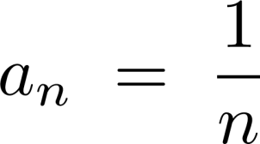
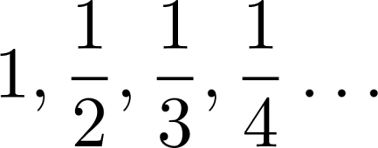
Sequences
Example: Consider the sequence
where

Slide 7
Sequences
EXAMPLE:
Write the first four terms of the sequence defined by the formula: bj = 1 + 2^{𝑗}, for all integers j ≥ 0 SOLUTION:
b0 = 1 + 2⁰ = 1 + 1 = 2
b1 = 1 + 2¹ = 1 + 2 = 3
b2 = 1 + 2² = 1 + 4 = 5
b3 = 1 + 2³ = 1 + 8 = 9 REMARK:
The formula bj = 1 + 2^{𝑗}, for all integers j ≥ 0 defines an infinite sequence having infinite number of values.

Slide 8
Sequences
EXERCISE:
Compute the first six terms of the sequence defined by the formula
Cn = 1+ (−1)^{𝑛} for all integers n ≥ 0
SOLUTION :
C0 = 1 + (−1)⁰ = 1 + 1 = 2
C1 = 1 + (−1)¹ = 1 + (-1) = 0
C2 = 1 + (−1)² = 1 + 1 = 2
C3 = 1 + (−1)³ = 1 + (-1) = 0
C4 = 1 + (−1)⁴ = 1 + 1 = 2
C5 = 1 + (−1)⁵ = 1 + (-1) = 0
REMARK:
If n is even, then Cn = 2 and if n is odd, then Cn = 0. Hence, the sequence oscillates endlessly between 2 and 0.
An infinite sequence may have only a finite number of

Slide 9

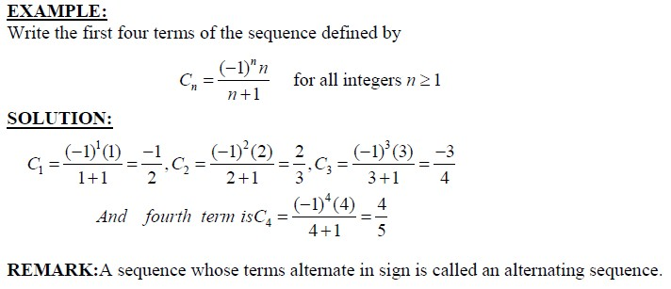
Sequences

Slide 10

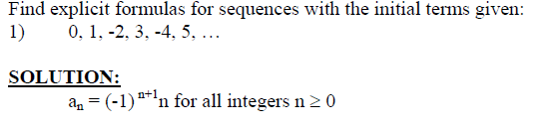
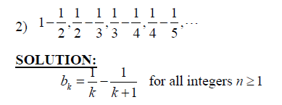
Sequences

Slide 11

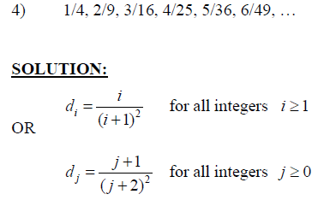
Sequences

Slide 12
Arithmetic Progression OR Sequences
A sequence in which every term after the first is obtained from the preceding term by adding a constant number is called an arithmetic sequence or arithmetic progression (A.P.)
The constant number, being the difference of any two consecutive terms is called the common difference of A.P., commonly denoted by “d”.
EXAMPLES:
5, 9, 13, 17, … (common difference = 4)
2. 0, -5, -10, -15, … (common difference = -5)
3. x + a, x + 3a, x + 5a, … (common difference =
2a)

Slide 13
Arithmetic Sequences
GENERAL TERM OF AN ARITHMETIC SEQUENCE:
Let a be the first term and d be the common difference of an arithmetic sequence. Then the sequence is:
a, a+d, a+2d, a+3d, …
If ai, for i ≥ 1, represents the terms of the sequence then a1 = first term = a = a + (1-1) d
a2 = second term = a + d = a + (2-1) d a3 = third term = a + 2d = a + (3 -1) d By symmetry
an = nth term = a + (n - 1)d for all integers n ≥1.

Slide 14

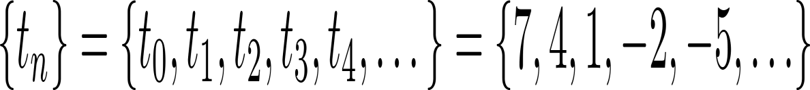
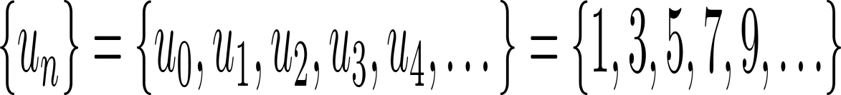
Arithmetic Sequences
Examples:
1. Let a = −1 and d = 4:
2. Let a = 7 and d = −3:
3. Let a = 1 and d = 2:

Slide 15
Arithmetic Sequences
EXAMPLE:
Find the 20th term of the arithmetic sequence
3, 9, 15, 21, …
SOLUTION:
Here a = first term = 3
d = common difference = 9 - 3 = 6
n = term number = 20
a20 = value of 20th term = ?
Since an = a + (n - 1) d; n ≥1
∴ a20 = 3 + (20 - 1) 6
= 3 + 114
= 117

Slide 16
Arithmetic Sequences
EXERCISE:
Find the 36th term of the arithmetic sequence whose 3rd term is 7 and 8th term is 17.
SOLUTION:
Let a be the first term and d be the common difference of the
arithmetic sequence.
Then an = a + (n - 1)d n ≥ 1
⇒ a3 = a + (3 - 1) d and a8 = a + (8 - 1) d
Given that a3 = 7 and a8 = 17. Therefore
7 = a + 2d……………………(1) and 17 = a +
7d………….………..(2)
Subtracting (1) from (2), we get, 10 = 5d ⇒ d = 2 Substituting d = 2 in (1) we have 7 = a + 2(2) which gives a = 3

Slide 17
Arithmetic Sequences
Thus, an = a + (n - 1) d
an = 3 + (n - 1) 2 (using values of a and d)
Hence the value of 36th term is a36 = 3 + (36 - 1) 2
= 3 + 70
a36 = 73

